Slide 1
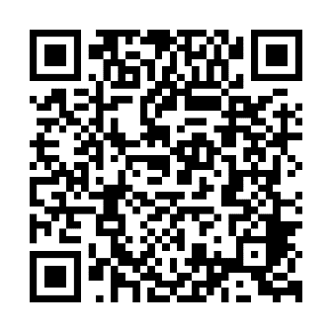
If you could choose to save a life, would you?
More than 5,000 people in Illinois and Indiana are waiting for life-saving organ transplants.
Every major religion in the United States supports organ donation as one of the highest expressions of compassion and generosity.
Learn more about religious perspectives on donation and transplantation at giftofhope.org.
Register your decision to be an organ, eye and tissue donor and talk with your family.
Notes:
Note to Presenter: Briefly mention what you will be discussing during your time with the attendees

